Slide 1
BLG 231E – Recitation #5 Synchronous Sequential Circuits
Res. Ast. Tuğba PAMAY (2019 Fall)

Slide 2
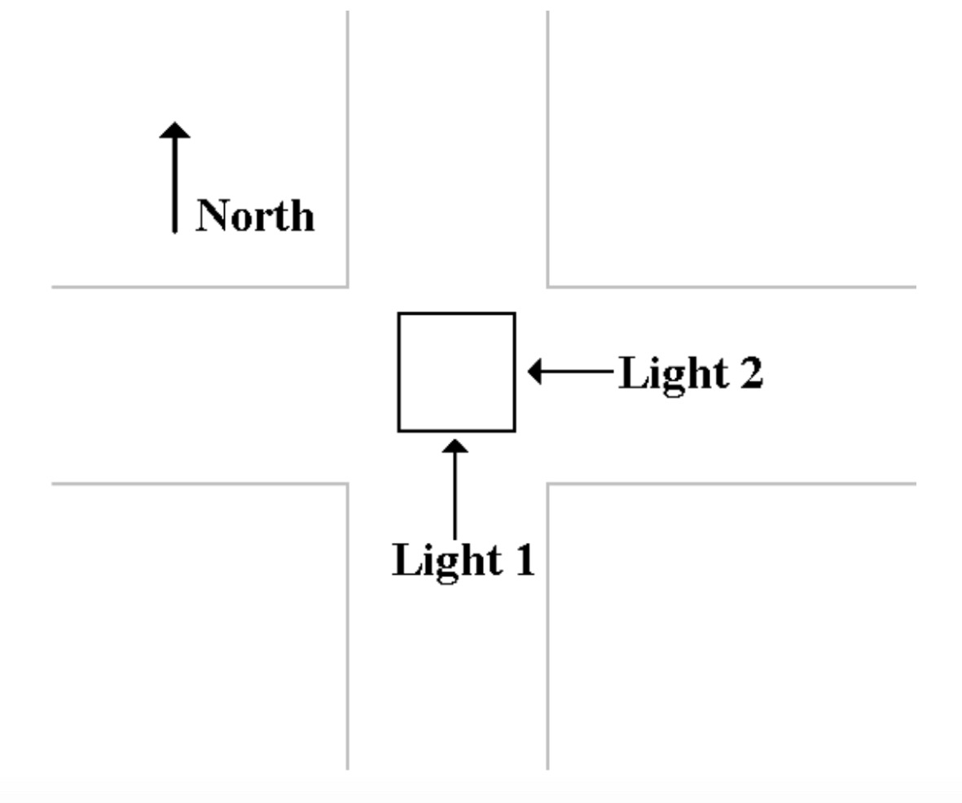
A Controller for a Simple Traffic Light
Assumptions:
2 linked pairs of traffic lights
Traffic flows:
Right to left
Bottom up
3 colors in a light: Red (R), Green (G), Yellow (Y)
«Yellow» light is for only before stop (Red light)

Slide 3
A Controller for a Simple Traffic Light
Assumed actions:
One Light | Cross Light | Action
Green | Red | Traffic moving in one direction
Yellow | Red | Cars moving are preparing to stop.
Red | Red | Traffic in both roads stop for a second
Red | Green | Traffic moving in other direction

Slide 4
Step #1: Name the States
State_ID | Light #1 | Light #2 | Alias
0 | Red | Red | RR
1 | Red | Green | RG
2 | Red | Yellow | RY
3 | Red | Red | RR
4 | Green | Red | GR
5 | Yellow | Red | YR

Slide 5
Step #2: State Diagram
State_ID
0
1
2
3
4
5
Alias
RR
RG
RY
RR
GR
YR
RG
RY
RR
RR
YR
GR

Slide 6
Step #3: Define State Table
Current State |  | Next State
State_ID | Alias | State_ID | Alias
0 | RR | 1 | RG
1 | RG | 2 | RY
2 | RY | 3 | RR
3 | RR | 4 | GR
4 | GR | 5 | YR
5 | YR | 0 | RR
RG
RY
RR
RR
YR
GR

Slide 7
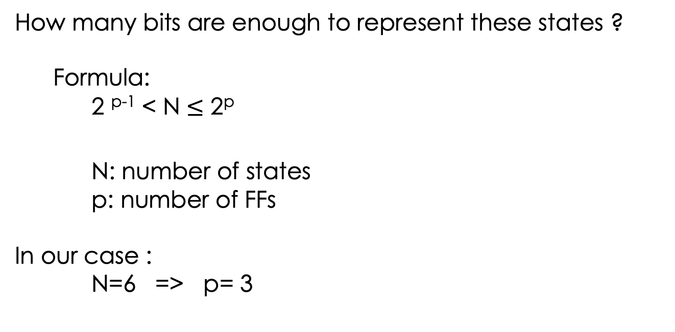
Step #4: How many FF do we need?
How many bits are enough to represent these states ?
Formula:
2 ^{p-1} < N $≤$ 2^{p}
N: number of states
p: number of FFs
In our case :
N=6 => p= 3

Slide 8
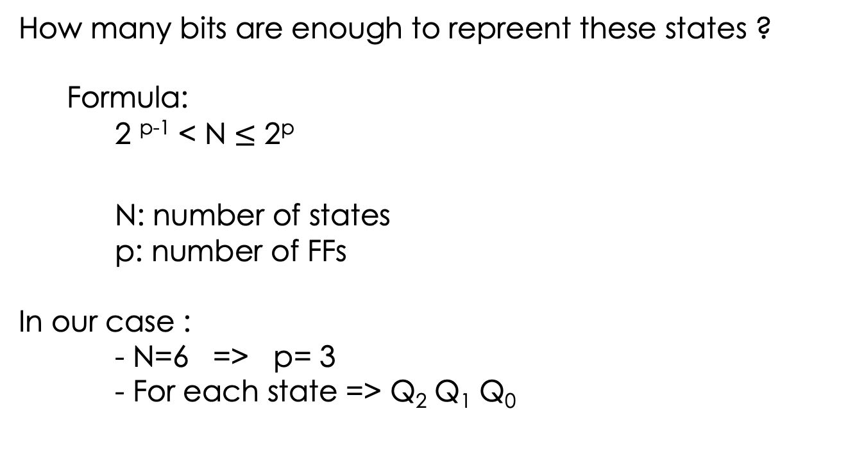
Step #4: How many FF do we need?
How many bits are enough to repreent these states ?
Formula:
2 ^{p-1} < N $≤$ 2^{p}
N: number of states
p: number of FFs
In our case :
- N=6 => p= 3
- For each state => Q₂ Q₁ Q₀

Slide 9
Step #5: Assign 3-bit Binary Number to each state
State_ID | Alias | Q₂ Q₁ Q₀
0 | RR | 000
1 | RG | 001
2 | RY | 010
3 | RR | 011
4 | GR | 100
5 | YR | 101

Slide 10
Step #6: Derive the Output Equations
# of outputs:
2 traffic lights * 3 different colors: 6 outputs in total
R1, Y1, G1, R2, Y2, G2

Slide 11
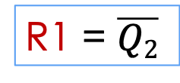
Step #6: Derive the Output Equations
State_ID | Alias | Q₂ Q₁ Q₀
0 | RR | 000
1 | RG | 001
2 | RY | 010
3 | RR | 011
4 | GR | 100
5 | YR | 101
Step #6.1: R1
Q₁Q₀ Q₂ | 00 | 01 | 11 | 10
0 | 1 | 1 | 1 | 1
1 | 0 | 0 | ∅ | ∅
R1 = $\overline{Q2}$

Slide 12
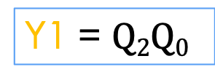
Step #6: Derive the Output Equations
State_ID | Alias | Q₂ Q₁ Q₀
0 | RR | 000
1 | RG | 001
2 | RY | 010
3 | RR | 011
4 | GR | 100
5 | YR | 101
Step #6.2: Y1
Q₁Q₀ Q₂ | 00 | 01 | 11 | 10
0 | 0 | 0 | 0 | 0
1 | 0 | 1 | ∅ | ∅
Y1 = $Q2Q0$
Notes:
The important is that we also cover the dont care bit beside the bit 1 for Y1 ?
Why ?
To reduce cost!

Slide 13
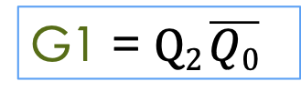
Step #6: Derive the Output Equations
State_ID | Alias | Q₂ Q₁ Q₀
0 | RR | 000
1 | RG | 001
2 | RY | 010
3 | RR | 011
4 | GR | 100
5 | YR | 101
Step #6.3: G1
Q₁Q₀ Q₂ | 00 | 01 | 11 | 10
0 | 0 | 0 | 0 | 0
1 | 1 | 0 | ∅ | ∅
G1 = $Q2 \overline{Q0}$

Slide 14
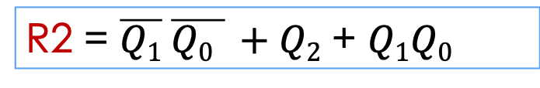
Step #6: Derive the Output Equations
State_ID | Alias | Q₂ Q₁ Q₀
0 | RR | 000
1 | RG | 001
2 | RY | 010
3 | RR | 011
4 | GR | 100
5 | YR | 101
Step #6.4: R2
R2 = $\overline{Q1} \overline{Q0 } +Q2$ + $Q1Q0$
Q₁Q₀ Q₂ | 00 | 01 | 11 | 10
0 | 1 | 0 | 1 | 0
1 | 1 | 1 | ∅ | ∅

Slide 15
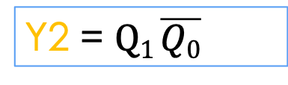
Step #6: Derive the Output Equations
State_ID | Alias | Q₂ Q₁ Q₀
0 | RR | 000
1 | RG | 001
2 | RY | 010
3 | RR | 011
4 | GR | 100
5 | YR | 101
Step #6.5: Y2
Q₁Q₀ Q₂ | 00 | 01 | 11 | 10
0 | 0 | 0 | 0 | 1
1 | 0 | 0 | ∅ | ∅
Y2 = $Q1 \overline{Q0}$

Slide 16
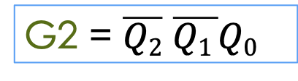
Step #6: Derive the Output Equations
State_ID | Alias | Q₂ Q₁ Q₀
0 | RR | 000
1 | RG | 001
2 | RY | 010
3 | RR | 011
4 | GR | 100
5 | YR | 101
Step #6.6: G2
Q₁Q₀ Q₂ | 00 | 01 | 11 | 10
0 | 0 | 1 | 0 | 0
1 | 0 | 0 | ∅ | ∅
G2 = $\overline{Q2}$ $\overline{Q1 }Q0$

Slide 17
Step #7: Derive State Transition Table
State_ID | Alias | Q₂ Q₁ Q₀
0 | RR | 000
1 | RG | 001
2 | RY | 010
3 | RR | 011
4 | GR | 100
5 | YR | 101
Q₂⁺ Q₁⁺ Q₀⁺
Q₁Q₀ Q₂ | 00 | 01 | 11 | 10
0 | 001 | 010 | 100 | 011
1 | 101 | 000 | ∅ | ∅

Slide 18
Step #7: Derive State Transition Table
Q₂⁺ Q₁⁺ Q₀⁺
Q₂ Q₂⁺
Q₁Q₀ Q₂ | 00 | 01 | 11 | 10
0 | 001 | 010 | 100 | 011
1 | 101 | 000 | ∅ | ∅
Q₁Q₀ Q₂ | 00 | 01 | 11 | 10
0 | 00 | 00 | 01 | 00
1 | 11 | 10 | ∅ | ∅

Slide 19
Step #7: Derive State Transition Table
Q₂⁺ Q₁⁺ Q₀⁺
Q₁ Q₁⁺
Q₁Q₀ Q₂ | 00 | 01 | 11 | 10
0 | 001 | 010 | 100 | 011
1 | 101 | 000 | ∅ | ∅
Q₁Q₀ Q₂ | 00 | 01 | 11 | 10
0 | 00 | 01 | 10 | 11
1 | 00 | 00 | ∅ | ∅

Slide 20
Step #7: Derive State Transition Table
Q₂⁺ Q₁⁺ Q₀⁺
Q₀ Q₀⁺
Q₁Q₀ Q₂ | 00 | 01 | 11 | 10
0 | 001 | 010 | 100 | 011
1 | 101 | 000 | ∅ | ∅
Q₁Q₀ Q₂ | 00 | 01 | 11 | 10
0 | 01 | 10 | 10 | 01
1 | 01 | 10 | ∅ | ∅

Slide 21
Step #9: Derive Input Equations
# of inputs:
2 inputs * 3 JK FFs : 6 inputs in total
J0, K0, J1, K1, J2, K2

Slide 22

Step #8: Select the Flip–Flops
JK Flip Flop
Q = J $\overline{Q}$ + $\overline{K} Q$
Q | Q⁺ | J | K
0 | 0 | 0 | ∅
0 | 1 | 1 | ∅
1 | 0 | ∅ | 1
1 | 1 | ∅ | 0

Slide 23
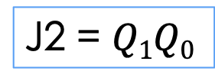
Step #9: Derive the Input Equations
Q₂ Q₂⁺
Q₁Q₀ Q₂ | 00 | 01 | 11 | 10
0 | 00 | 00 | 01 | 00
1 | 11 | 10 | ∅ | ∅
J2
Q₁Q₀ Q₂ | 00 | 01 | 11 | 10
0 | 0 | 0 | 1 | 0
1 | ∅ | ∅ | ∅ | ∅
Q | Q⁺ | J | K
0 | 0 | 0 | ∅
0 | 1 | 1 | ∅
1 | 0 | ∅ | 1
1 | 1 | ∅ | 0
J2 = $Q1Q0$

Slide 24
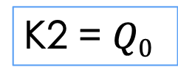
Step #9: Derive the Input Equations
Q₂ Q₂⁺
Q₁Q₀ Q₂ | 00 | 01 | 11 | 10
0 | 00 | 00 | 01 | 00
1 | 11 | 10 | ∅ | ∅
K2
Q₁Q₀ Q₂ | 00 | 01 | 11 | 10
0 | ∅ | ∅ | ∅ | ∅
1 | 0 | 1 | ∅ | ∅
Q | Q⁺ | J | K
0 | 0 | 0 | ∅
0 | 1 | 1 | ∅
1 | 0 | ∅ | 1
1 | 1 | ∅ | 0
K2 = $Q0$

Slide 25
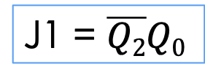
Step #9: Derive the Input Equations
Q₁ Q₁⁺
J1
Q₁Q₀ Q₂ | 00 | 01 | 11 | 10
0 | 00 | 01 | 10 | 11
1 | 00 | 00 | ∅ | ∅
Q₁Q₀ Q₂ | 00 | 01 | 11 | 10
0 | 0 | 1 | ∅ | ∅
1 | 0 | 0 | ∅ | ∅
Q | Q⁺ | J | K
0 | 0 | 0 | ∅
0 | 1 | 1 | ∅
1 | 0 | ∅ | 1
1 | 1 | ∅ | 0
J1 = $\overline{Q2}Q0$

Slide 26
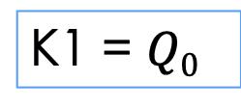
Step #9: Derive the Input Equations
Q₁ Q₁⁺
K1
Q₁Q₀ Q₂ | 00 | 01 | 11 | 10
0 | 00 | 01 | 10 | 11
1 | 00 | 00 | ∅ | ∅
Q₁Q₀ Q₂ | 00 | 01 | 11 | 10
0 | ∅ | ∅ | 1 | 0
1 | ∅ | ∅ | ∅ | ∅
Q | Q⁺ | J | K
0 | 0 | 0 | ∅
0 | 1 | 1 | ∅
1 | 0 | ∅ | 1
1 | 1 | ∅ | 0
K1 = $Q0$

Slide 27
Step #9: Derive the Input Equations
Q₀ Q₀⁺
J0
Q₁Q₀ Q₂ | 00 | 01 | 11 | 10
0 | 01 | 10 | 10 | 01
1 | 01 | 10 | ∅ | ∅
Q₁Q₀ Q₂ | 00 | 01 | 11 | 10
0 | 1 | ∅ | ∅ | 1
1 | 1 | ∅ | ∅ | ∅
Q | Q⁺ | J | K
0 | 0 | 0 | ∅
0 | 1 | 1 | ∅
1 | 0 | ∅ | 1
1 | 1 | ∅ | 0
J0 = 1

Slide 28
Step #9: Derive the Input Equations
Q₀ Q₀⁺
K0
Q₁Q₀ Q₂ | 00 | 01 | 11 | 10
0 | 01 | 10 | 10 | 01
1 | 01 | 10 | ∅ | ∅
Q₁Q₀ Q₂ | 00 | 01 | 11 | 10
0 | ∅ | 1 | 1 | ∅
1 | ∅ | 1 | ∅ | ∅
Q | Q⁺ | J | K
0 | 0 | 0 | ∅
0 | 1 | 1 | ∅
1 | 0 | ∅ | 1
1 | 1 | ∅ | 0
K0 = 1

